Slide 1

Department of Computer Science
University Institute of Engineering
DEPARTMENT OF COMPUTER SCIENCE & ENGINEERING
Bachelor of Engineering
Subject Name: System Programming
Subject Code: CST-315
Compilers
DISCOVER . LEARN . EMPOWER

Slide 2
1. Cross Compiler

Slide 3
1. Cross Compiler
Compilers are of two kinds: native and cross .
Native compilers are written in the same language as the target language. For example, SMM is a compiler for the language S that is in a language that runs on machine M and generates output code that runs on machine M.
Cross compilers are written in different language as the target language. For example, SNM is a compiler for the language S that is in a language that runs on machine N and generates output code that runs on machine M.

Slide 4
1. Cross Compiler
A compiler is defined by three languages −
S→ Source language it compiles.
T→ Target language it generates.
I→ Implementation language that it is written in
These languages can be represented using a T-diagram as

Slide 5
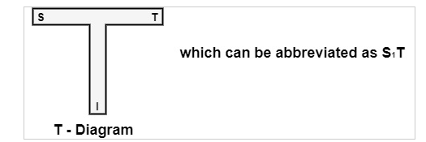
1. Cross Compiler
A compiler is defined by three languages −
S→ Source language it compiles.
T→ Target language it generates.
I→ Implementation language that it is written in
These languages can be represented using a T-diagram as

Slide 6
1. Cross Compiler
Cross Compiler
A compiler can run on one machine and produce target code for another machine.
Such a compiler is known as a cross-compiler.
Cross Compiler - A type of Compiler that generate machine code targeted to run on a system different than the one generating it

Slide 7
1. Cross Compiler
Windows
(Complier)
Linux

Slide 8
1. Cross Compiler
C
GCC
Working on OLD Machine 8 bit / 16 bit

Slide 9
1. Cross Compiler
Working on OLD Machine 8 bit / 16 bit
GCC
New Machine 64 bit
Intel I3

Slide 10
1. Cross Compiler
Linux
HLL
Front End
Back End
Target Language
Synthesis Phase
Analysis Phase

Slide 11
1. Cross Compiler
If it can write a cross-compiler for a new language 'L' in execution languages 'S' to generate a program for machine 'N'.
i.e. LsN
If a current compiler for S runs on machine M and generates a program for M, it is defined by S_{M}M.
If L_{S}N runs through S_{M}M, we get a compiler L_{M}N, i.e., a compiler from L to N that runs on M.

Slide 12
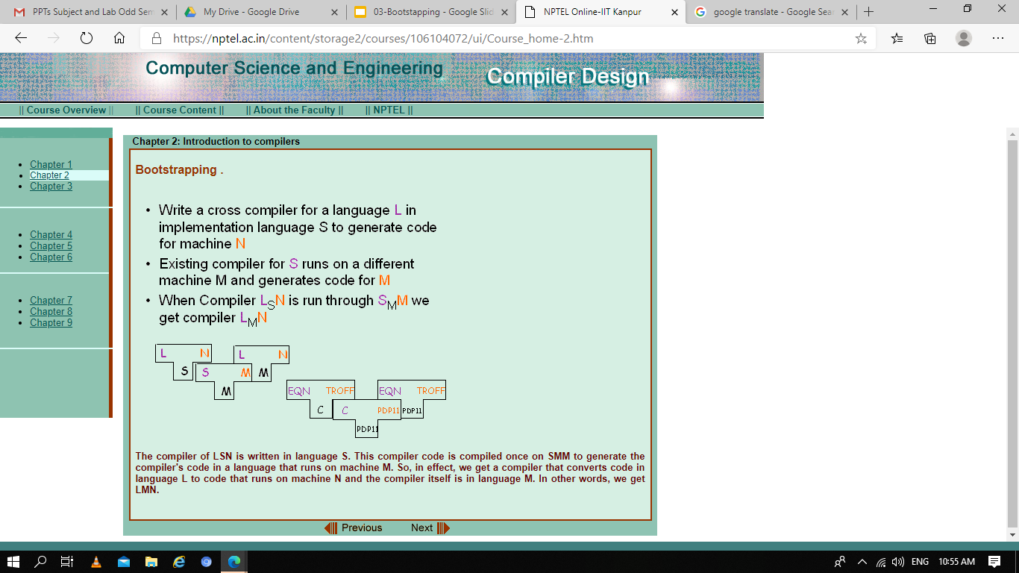
1. Cross Compiler
If it can write a cross-compiler for a new language 'L' in execution languages 'S' to generate a program for machine 'N'. i.e. LsN
If a current compiler for S runs on machine M and generates a program for M, it is defined by S_{M}M.
If L_{S}N runs through S_{M}M, we get a compiler L_{M}N, i.e., a compiler from L to N that runs on M.

Slide 13
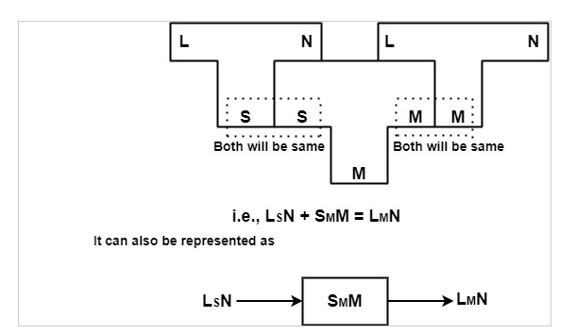

Slide 14
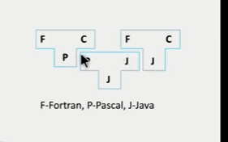
1. Cross Compiler

Slide 15
2. Bootstrapping for compilers

Slide 16
2. Bootstrapping for compilers
A technique used for compiler construction.
It is a process in which simple language is used to translate more complicated program which in turn may handle for more complicated program
Writing a compiler for any high level language is a complicated process.
It takes lot of time to write a compiler from scratch. Hence simple language is used to generate target code in some stages..

Slide 17
2. Bootstrapping for compilers
A technique to Produce Self-compiling Compiler – that is a compiler (Assembler ) written in a source programming language that is intend to compile
A initial version of the compiler( the bootstrap compiler) is generated in a different language (which could be assembly language) ; successive expended versions of the compiler are developed using this minimal subset of the language.

Slide 18
A Typical bootstrap process works in 3 or 4 stages
Stage 0 : Preparing a environment for the bootstrap compiler to work
Stage 1: the bootstrap compiler is produced
Stage 2: A full compiler is produced by the bootstrap compiler
Stage 3: A full compiler is produced by the stage 2 full bootstrap compiler

Slide 19
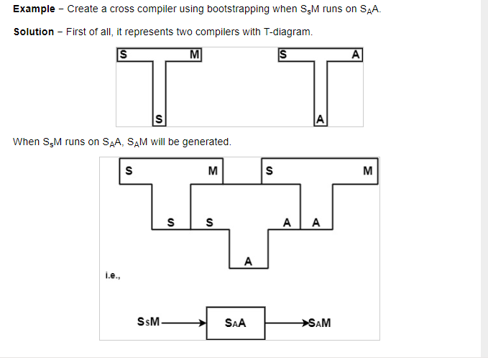

Slide 21
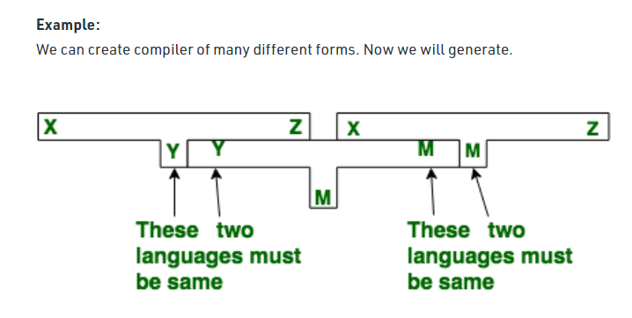
2. Bootstrapping for compilers
.

Slide 22
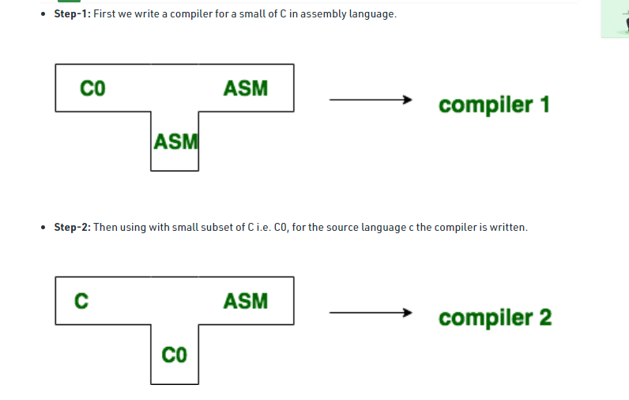
2. Bootstrapping for compilers
Compiler which takes C language and generates an assembly language as an output with the availability of a machine of assembly language.

Slide 23
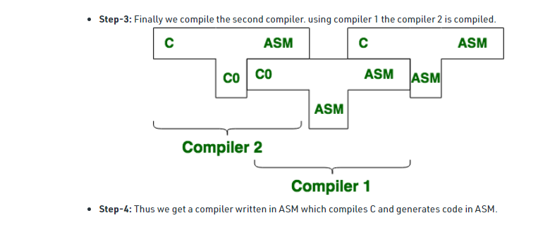
2. Bootstrapping for compilers

Slide 24
2. Bootstrapping for compilers
Uses of Bootstrapping
There are various uses of bootstrapping which are as follows −
It can allow new programming languages and compilers to be developed starting from actual ones.
It allows new features to be combined with a programming language and its compiler.
It also allows new optimizations to be added to compilers.
It allows languages and compilers to be transferred between processors with different instruction sets

Slide 25
2. Bootstrapping for compilers
Advantages of Bootstrapping
There are various advantages of bootstrapping which are as follows −
Compiler development can be performed in the higher-level language being compiled.
It is an inclusive consistency check as it must be capable of recreating its object code.

Slide 26
3. Difference between bootstrapping and cross compiler

Slide 27
difference between bootstrapping and cross compiler
Bootstrapping is the process of implementing a compiler in the language that it is supposed to compile.
Alternatively, cross-compilation is the process where a compiler executes on one computer architecture and generates target programs to be executed on another computer architecture.

Slide 28
THANK YOU

